Slide 1
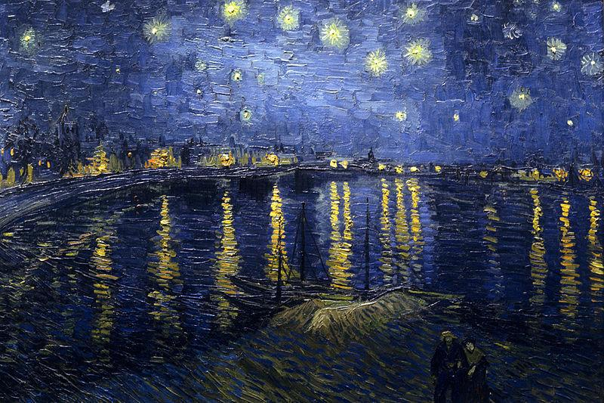
HVM - Art Connoisseur
Classifying Paintings by Artist
W251 Spring 2021 Team 12
Haoyu Zhang, Patrick Kim, Yixun Zhang

Slide 2
Proposal of Han van Meegeren
Han van Meegeren, a Dutch painter, portraitist and art forger
Data Source: Best Artworks of All Time dataset from Kaggle
Project Goals: Train an image classifier on the cloud to identify which artists painted a particular artwork, and get this model working on edge devices
Future Work: Classifying art by genre, nationality, time period

Slide 3
Thank you

